Slide 1
Killington 2018: For Shredding and Society
SOM Ski and Snowboard Club

Slide 2
Killington Basics
February 1st/2nd through 4th
All SOM & SOM Partners welcome!
3.5-4 hour drive (bus ride) from New Haven
Largest Ski Resort in the Eastern US with the largest vertical drop in New England
212 Runs with 22 Lifts (2 gondolas, and 5 high speed quads)

Slide 3
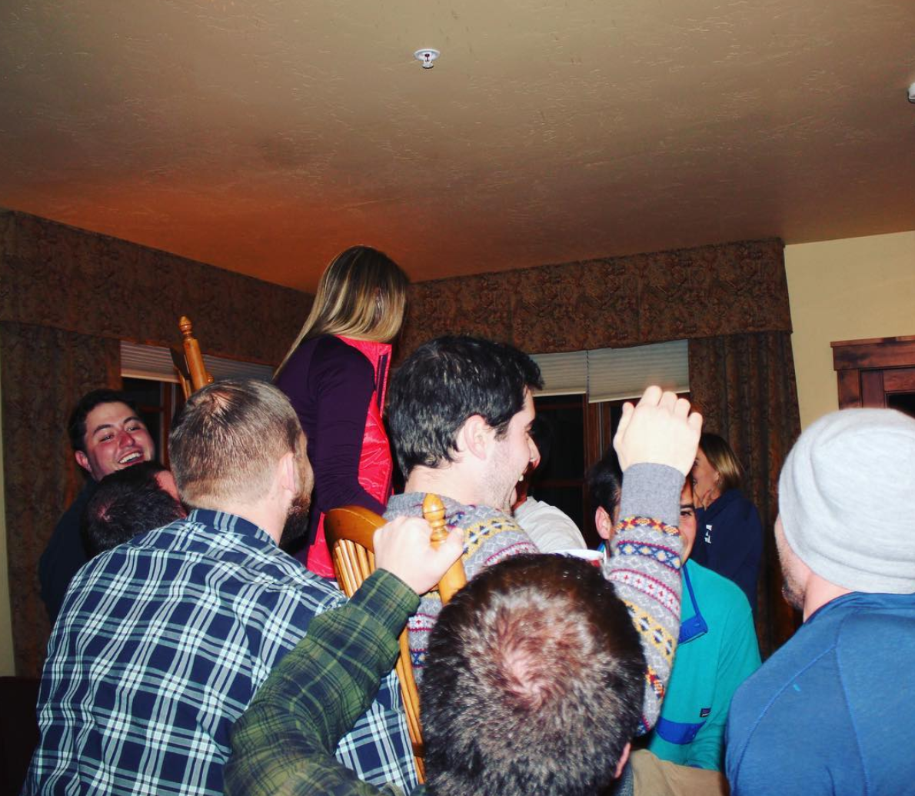
Killington value prop
Included in Base ($440)
Lodging
2 Day Lift Ticket
2 Nights in the SOM Wild
1 Night of Pizza
Transportation to and from Venues at Killington
Partying with 300 of your friends all weekend plus SWAG
Total - $440
EPIC Times

Slide 4
Add-Ons
Thursday night lodging +$60
3 Day Lift Ticket +$45
1 Day Lift Ticket ($45)
No Lift Tickets ($90)
1 Day Equipment Rental +$45
2 Day Equipment Rental +$90
3 Day Equipment Rental +$135
1 Day 1st time skier/snowboarder lesson +$140
2 Day 1st time skier/snowboarder lesson (3rd day is free) +$230
2 Consecutive ½ day Group ski or snowboard lesson +$150

Slide 5
Killington Weekend – Overview
Friday night: Pickle Barrel (transportation, entry and drink ticket included in price)
Saturday: Happy Hour (transportation and drink tickets included)
Saturday: Outback Pizza Party (food and transportation included in price)

Slide 6
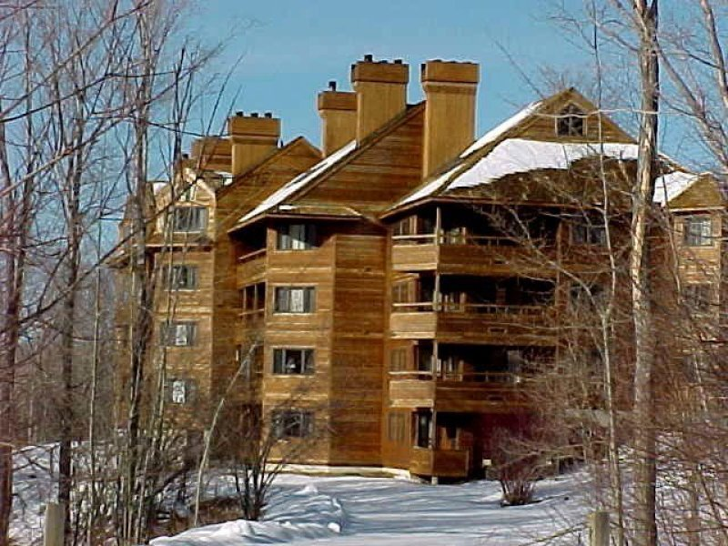
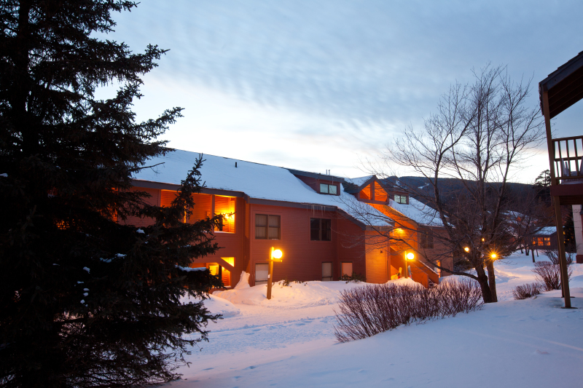
Cabins
High Ridge:
1, 2 or 4 bedroom condos
Trail Creek:
1 or 2 bedroom condos
Pricing based on double occupancy
Notes:
Trail Creek http://www.killington.com/site/plan/managed/managed/206041215
Highridge
http://www.killington.com/site/plan/managed/managed/206041147

Slide 7
Bus Transportation
Coach bus – the party before the party
Separate cost depending on number of signups
One departure Thursday
One departure Friday
Return Sunday

Slide 8
Timeline
Figure out Room and Captains
01
Now!
Captains Register
02
Monday, December 4 at 8 am.
Everyone Registers
03
Wednesday, December 6 at 8am.
GO TO KILLINGTON!
05
February 1-4
Registration Closes
04
Tuesday, January 2.

Slide 9
Condo Captain Registration

Slide 10
Condo Captain Registration

Slide 11
Choose your number of nights and number of bedrooms

Slide 12
Choose your lift ticket
If you’re planning on taking a ski lesson, you don’t need lift tickets for the day of your lesson.

Slide 13
Choose your Rental Option
If you’re taking a ski lesson, you don’t need rentals for the day of your lesson.

Slide 14
Add Ski School or Insurance

Slide 15
Add Ski School or Insurance

Slide 16
Enter Personal Information, agree to terms and complete payment form

Slide 17
Check your mail!

Slide 18
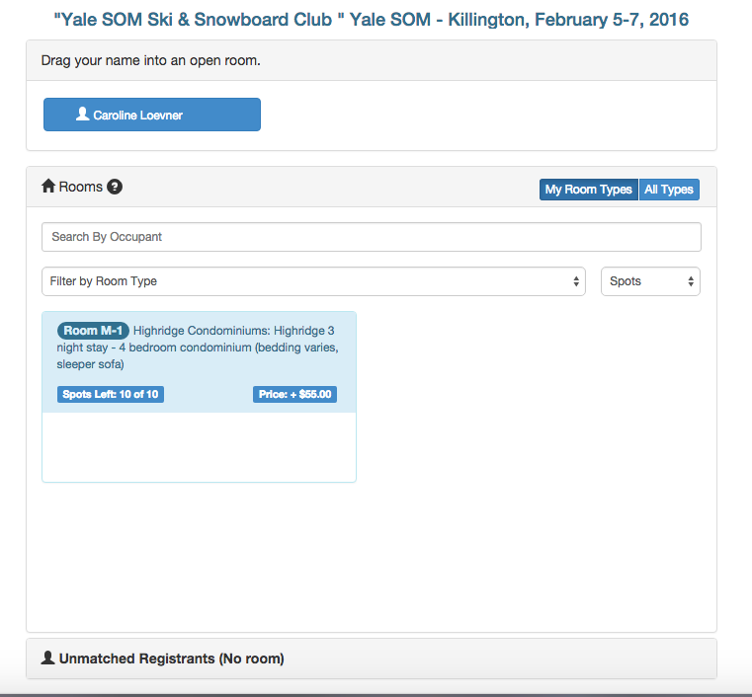
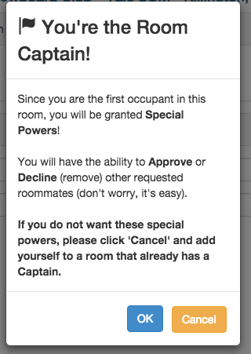
Captain: Drag your name to a new room of the type and length of stay selected

Slide 19
Condo Guest Registration

Slide 20
Note the Room Type of your Captain

Slide 21
Select Same Room Type as Captain and complete booking as before

Slide 22
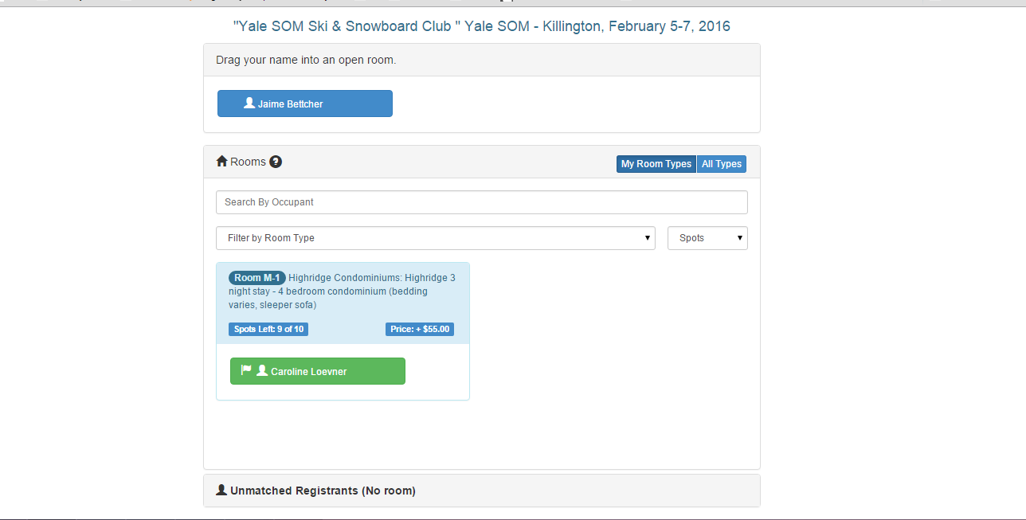
Guests: Drag your name to the room of your captain

Slide 23
Captain: Approve your Guests to finalize their booking

Slide 24
What if I can’t go?
Make sure you can commit to the trip before booking!
Refund policy: The company we are working through can’t provide full refunds once you book BUT you are able to sell your spot to another student!
Full Refund Policy: If someone cancels and finds a replacement they lose some minimal amount of their deposit. If someone cancels and doesn’t find a replacement they get refunded their ticket and rental costs but no more.

Slide 25
Important things to know
Booking opens for captains on Monday 4 December
Booking opens for guests on Wednesday 6 December
Booking closes 2 January 2016
You can only room with people staying the same number of nights
If you try to sign up for a different room type or number of nights than booked, you’ll get a request to change your original room booking
Captains are responsible for filling the whole house. If the house is not filled by the end of the booking period (3 January) the cost of the empty beds will be split across house occupants
Make sure you have joined the Ski & Snowboard club on Campus Groups to get all emails and notifications

